Slide 1
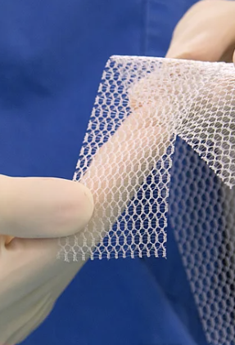
Case Study on Product Liability Transvaginal Mesh
Case Study: Transvaginal Mesh Product Liability Litigation
RGA 6205|Prof. Andreea Mocanu |By: Divya Vijayan
Medical devices: Transvaginal mesh implants for pelvic organ prolapse (POP) and stress urinary incontinence (SUI)
Brand name of product: ProteGen Sling. Other products: Obtryx Slings, Gynecare Prosima, etc.
Manufacturers: Boston Scientific. Others: Johnson & Johnson (Ethicon), C.R. Bard, American Medical Systems (AMS), and Coloplast
Over 73,000 product liability claims filed by 2014

Slide 2

Background of the Case
Transvaginal mesh products introduced in the 1990s
FDA issued first public health notification about risks in 2008
The first transvaginal mesh lawsuit was filed in 2009, marking the beginning of the vaginal mesh litigation. In the following years, thousands of lawsuits were filed against various TVM manufacturers
By 2011, FDA classified transvaginal mesh as high-risk device
Significant increase in lawsuits: 730 in 2011 to 34,017 in 2013

Slide 3
Key Legal Arguments
Plaintiffs' Claims:
Claims of negligent design, testing, and marketing practices.
Lack of adequate warnings to healthcare providers and patients.
Lawsuits emphasize the need for better communication on device safety.
Significant legal and reputational consequences for TVM producers.
Defendants' Arguments:
Products properly designed and tested
Risks disclosed to doctors
Injuries resulted from surgical technique, not product defects
Statute of Limitations Exceeded
Initial Symptoms were Noticeable Early
Post-Surgery Complications Known and Expected
Claim Timing Reflects Lack of Defective Awareness
Dismissal Request Due to Filing Delay

Slide 4

Significant outcomes
Multidistrict litigation (MDL) consolidated thousands of federal lawsuits
Notable verdicts:
- $11 million against Johnson & Johnson's Ethicon (2013)
- $302 million judgment against Johnson & Johnson upheld by U.S. Supreme Court (2023)
2008-2011: FDA issued warnings about complications and questioned the long-term efficacy of transvaginal mesh (TVM).
2012: Required manufacturers to conduct post-market safety studies.
2016-2019: TVM devices were reclassified to Class III, leading to a sales halt for insufficient safety evidence.
2020-2023: Increased scrutiny and recommendations for stricter approval processes for stress urinary incontinence (SUI) devices. By July 2022, 95% of all transvaginal mesh cases were resolved or dismissed
2024: Ongoing lawsuits prompted manufacturers to shift focus from mesh products to safer alternatives for pelvic organ prolapse (POP) and SUI.

Slide 5

Implications for Regulatory Affairs
Highlighted flaws in the approval process for high-risk devices
FDA imposed recall and effective ban on production and distribution in 2019
Increased scrutiny on post-market surveillance of medical devices
Emphasis on more comprehensive patient-informed consent
Only 12% of implanting surgeons were or became board-certified in Female Pelvic Medicine and Reconstructive Surgery
Key Takeaways:
Rigorous Testing & Surveillance: Emphasize thorough pre-market testing and ongoing post-market monitoring.
Clear Risk Communication: Ensure transparent risk disclosure to providers and patients.
Impact of Fast-Track Approvals: Reveal risks tied to expedited pathways for high-risk devices.
Manufacturer Risks: Highlight financial and reputational consequences of product safety failures.
Evolving Regulatory Standards: Drive stricter safety standards in medical device regulations.
Ref: https://www.lawsuit-information-center.com/vaginal-mesh-lawsuits-in-2024.html
https://www.drugwatch.com/transvaginal-mesh/lawsuits/
Thank you!

